Slide 1
Santo Village, Haiti
Compost-Based
Toilet System
5th International Dry Toilet Conference
Tampere University of Applied Sciences
19th – 22nd of August, 2015
Joseph Jenkins, Inc.
EcologicalSanitation.com

Slide 2
Nature suggests that we bury odorous things.

Slide 3
We bury corpses.
We deposit fecal material
into holes in the ground.

Slide 4
Science shows us a new way to bury organic material.

Slide 5
Instead of burying with dirt, we can bury with materials derived from plants.

Slide 6
When we bury odorous organic materials with plant material, we promote the growth of heat producing bacteria.

Slide 7
The resulting organic mass, called a compost pile, destroys human disease organisms.
Researchers include Gotaas, (1956 W.H.O.); Feachem, et al. (1980 World Bank). Franceys, R. et al. (1992 W.H.O.) and others.

Slide 8
This is the basis of sanitation and
the promotion of public health.

Slide 9
“Composting”
by definition, is
Managed
Aerobic
3) Produces biological heat

Slide 10
Most “dry toilets” are erroneously called “composting” toilets, but they do not compost. They dessicate, dehydrate, and decompose the toilet material.

Slide 11
Organic materials, including toilet materials, are composted simply by:
COLLECTING IN CONTAINERS
PILING IN COMPOST BINS
COVERING WITH PLANT MATERIAL

Slide 12
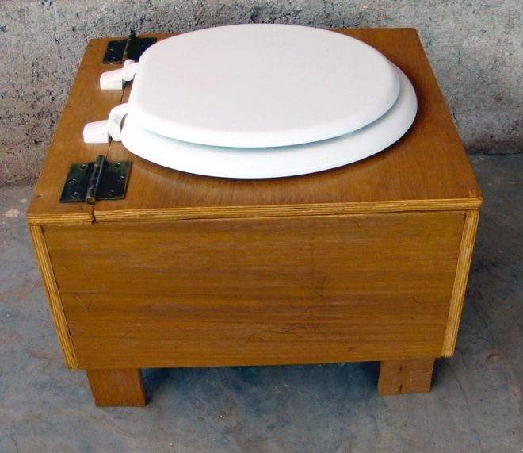
Compost toilets collect all toilet materials, including urine and toilet paper.

Slide 13
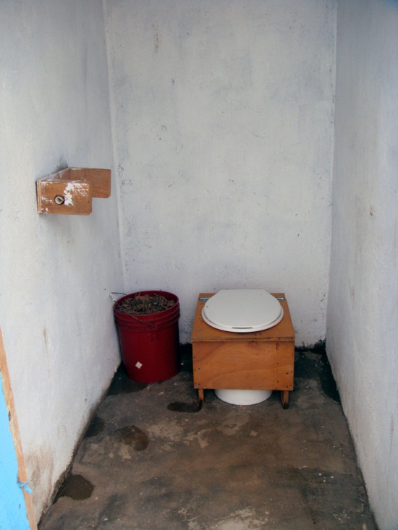
Here, a 20-liter receptacle under the toilet seat collects the feces, urine and paper.
Urine separation is not necessary when the collected material is being composted.

Slide 14
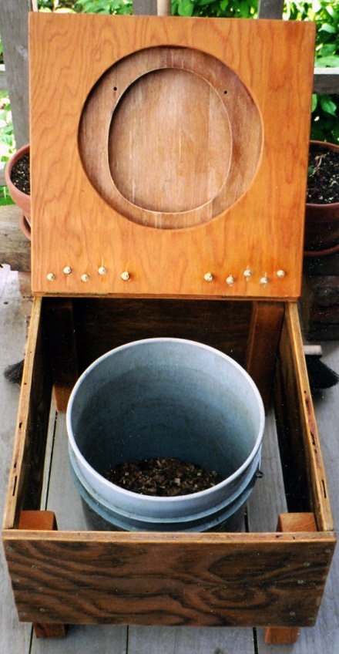
The contents are covered with the carbon-based plant material, which acts as a biofilter to prevent odor. The receptacle is easily removable.

Slide 15
The Santo Village in Leogane, Haiti, was a Habitat for Humanity planned Village for displaced families.

Slide 16
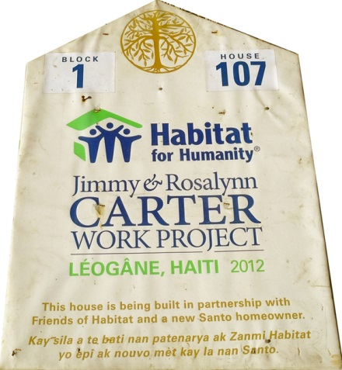
Jimmy Carter even worked at the site.

Slide 17
Their first sanitation choice was the Otji dry toilet, a urine separating, dehydrating toilet.

Slide 18
The expensive OTJI system failed, primarily due to odors, management issues, and environmental threats.
GiveLove.org then set up a true compost sanitation system in the Village.

Slide 19
True Composting
Step 1: Collect the organic material.

Slide 20
Step 2: Obtain appropriate cover material.

Slide 21
Step 3: Pile the organic material in bins.
Start by training.

Slide 22
Bins can be built with recycled pallets.
Begin with a “biological sponge.”

Slide 23
Each compost bin had its own label.

Slide 24
Toilet material is layered by the trained team, using bagasse as cover material.

Slide 25
Compost receptacles need to be rinsed.
The water is deposited into the bins.

Slide 26
250 households fill a 10 cubic meter bin every month.

Slide 27
The village has two compost sites; both are fenced and locked.

Slide 28
Toilet material is collected twice a week.
Users bring their full receptacles to the compost yards and swap them for clean ones.

Slide 29
This compost system requires no turning.

Slide 30
A compost shed at each site stores tools and equipment.

Slide 31
After a minimum of nine months, a beautiful, sanitary compost is produced. There is no odor.

Slide 32
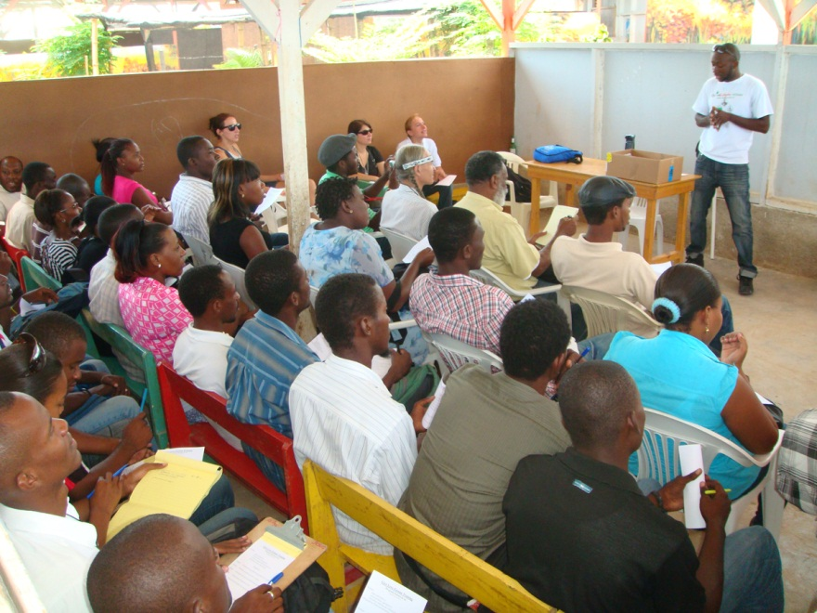
Public education helps to improve acceptance of this revolutionary sanitation system.

Slide 33
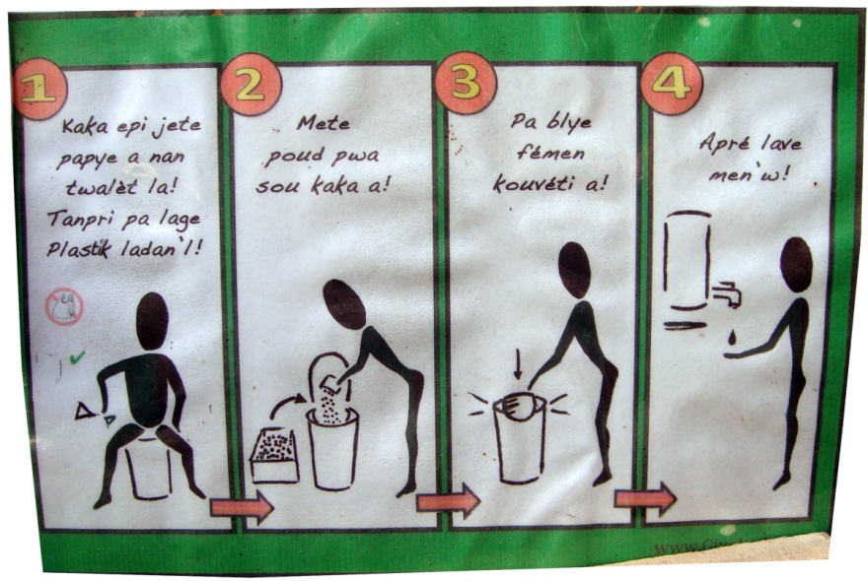
Instructions are posted inside each toilet.

Slide 34
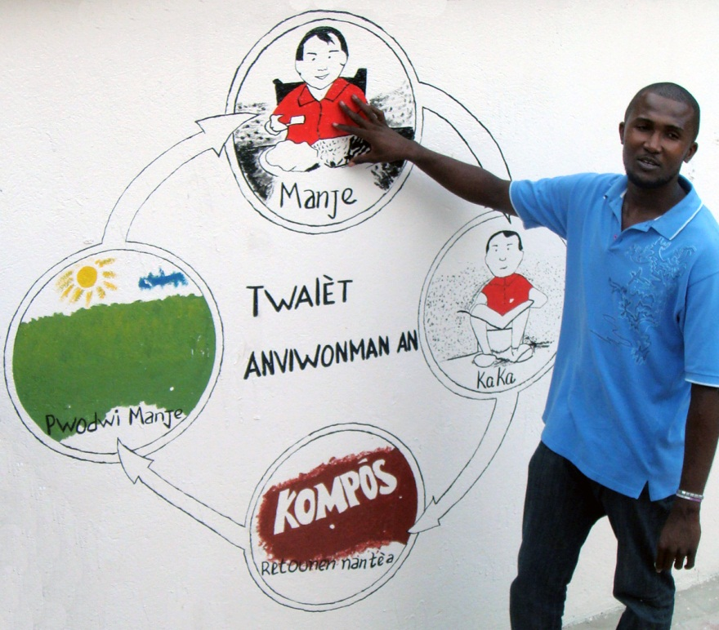
Composting recycles organic material.
There is no waste, no pollution, and no disposal.

Slide 35
The Santo Village project was created by GiveLove.org:
Patricia Arquette (Founder),
Alisa Keesey (Program Director),
Jean Lucho (Compost Instructor)
GiveLove.org is now working in
Nicaragua and India.

Slide 36
Download the full, illustrated paper on the Santo Village compost sanitation project:
humanurehandbook.com/downloads/Santo_Paper.pdf
QUESTIONS?
Presentation by Joe Jenkins
Joseph Jenkins, Inc., USA
EcologicalSanitation.com
joecjenkins@gmail.com

